Slide 1
Steph Chadwick
RE:Connect Teacher Fellowship Programme
Curriculum Project Feedback

Slide 2
My Project…
Climate Stories

Slide 3
Climate Stories
The Earth’s Story – What is the earth’s climate story?
Stories of Origin - What do we learn about the value of earth from creation stories?
Stories of Inspiration - How can stories inspire climate action?
My Climate Story – What is my own climate story?

Slide 4
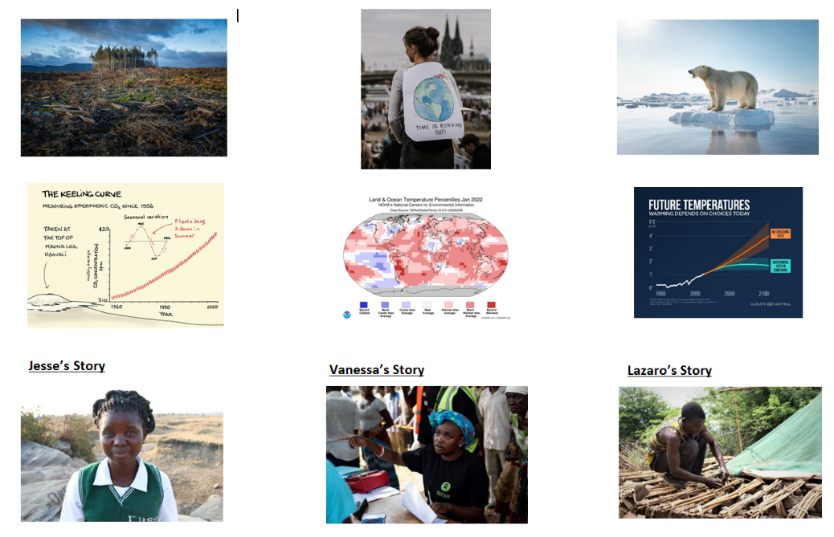
1 - The Earth’s Story
Opinion Statements starter – e.g.
I can explain fully what the term ‘Climate Change’ means.
The earth’s climate is changing and we need to do something to stop it.
I love planet earth.
Sources – what story do they tell?
What is the Earth’s story?

Slide 5
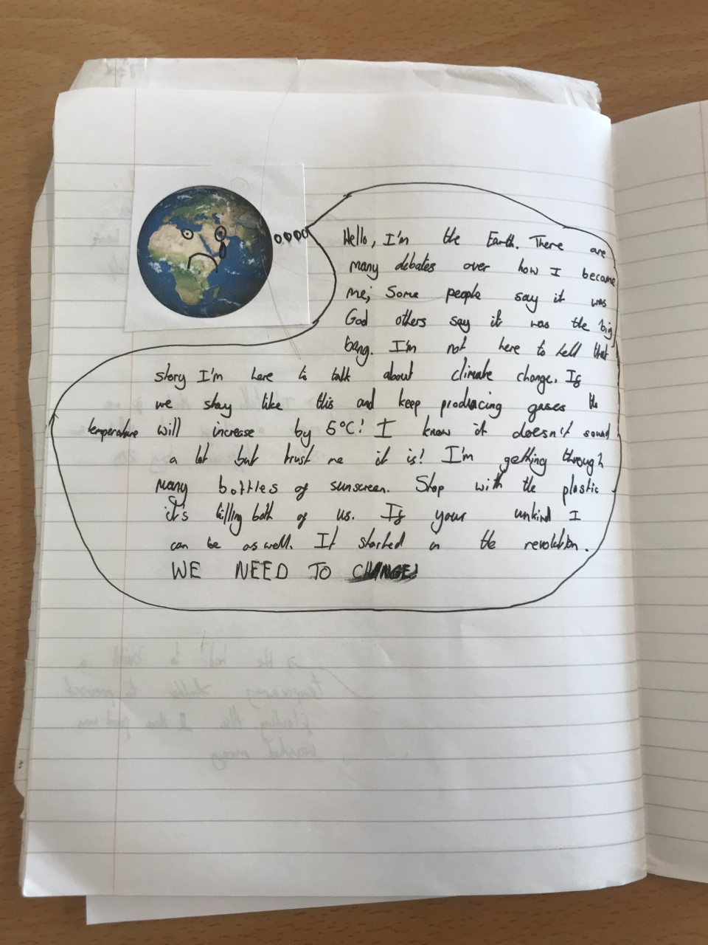
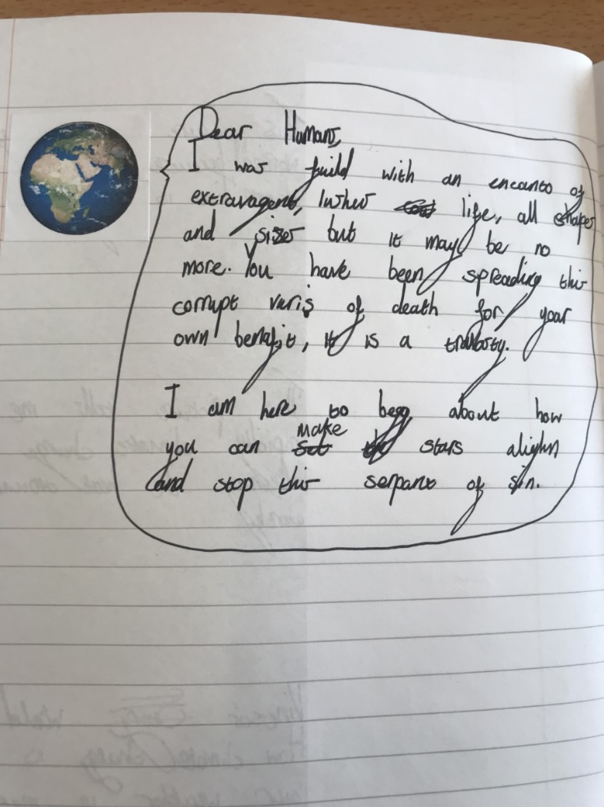
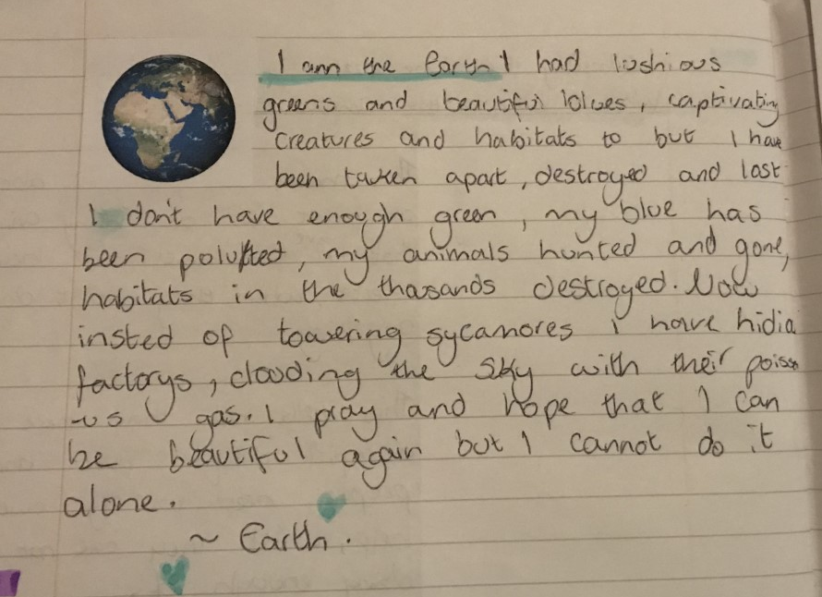
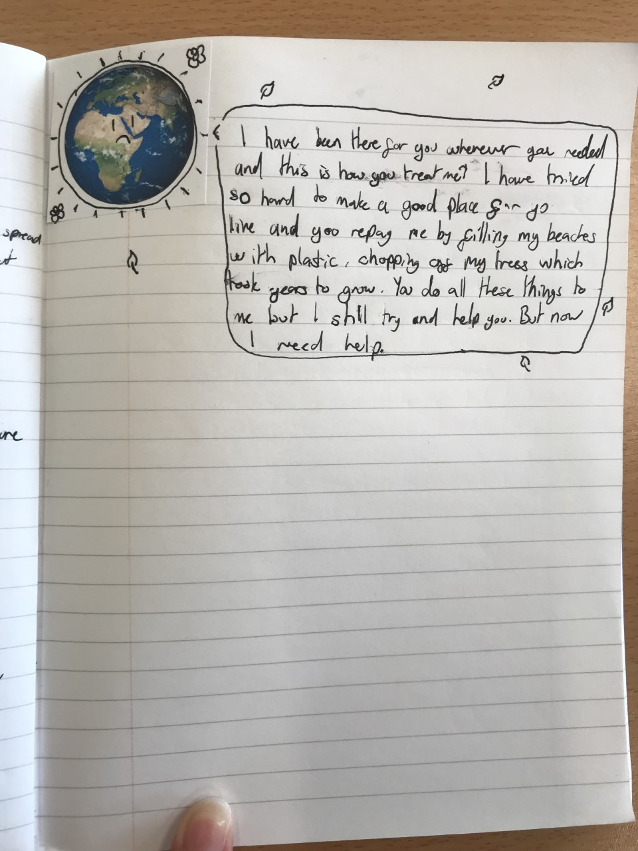

Slide 6
2 - Stories of Origin
Introduced Scriptural Reasoning
Went outside and sat in a circle in the shade of a tree
2 passages – Genesis 1 / The Scientific Narrative
How do the stories lead to an attitude of valuing the earth?
- Comparative claims of value

Slide 7
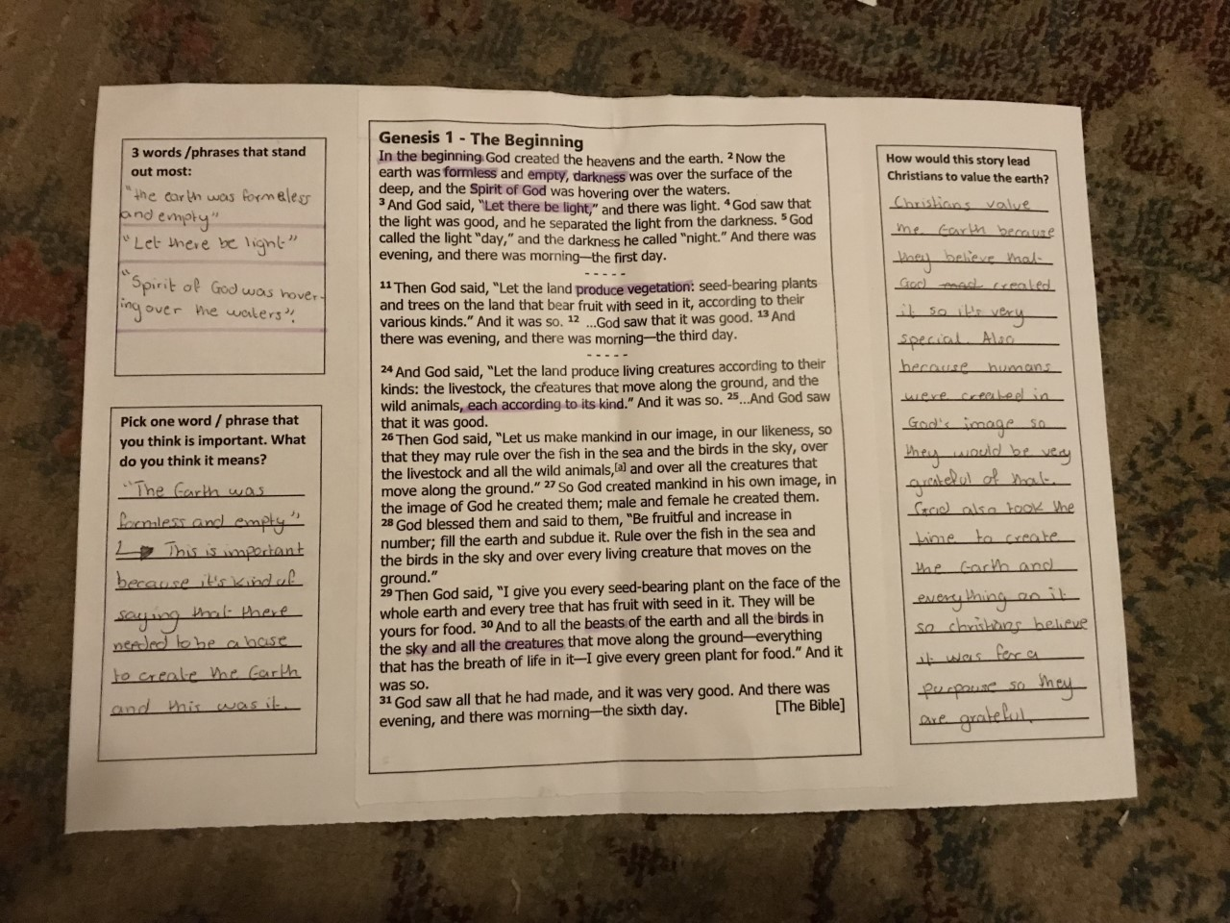
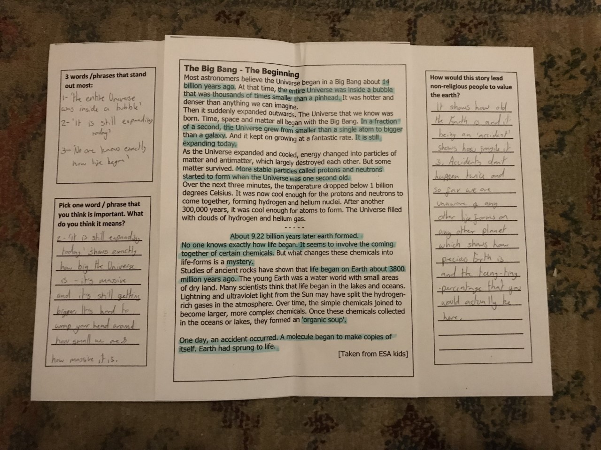

Slide 8
Stories of Inspiration
Poem starter – ‘The Tree’
Faith / non-faith activists and their stories
What inspires these people?
Leaves of inspiration

Slide 9
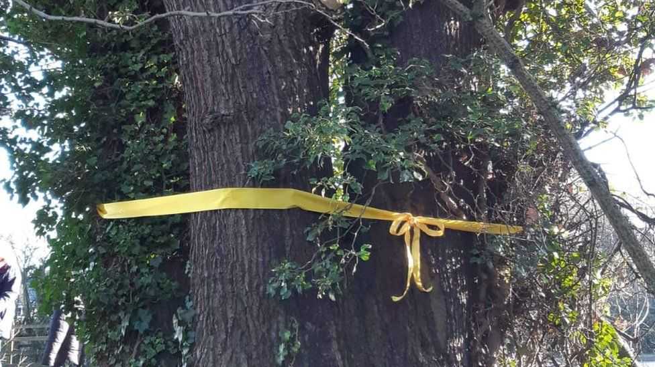
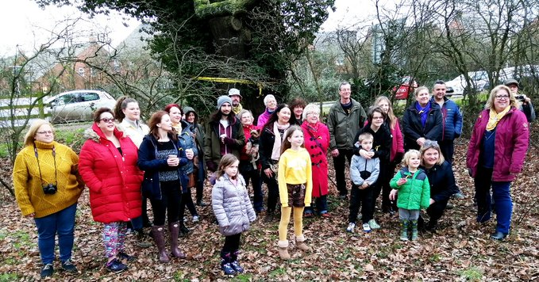

The Tree

Slide 10
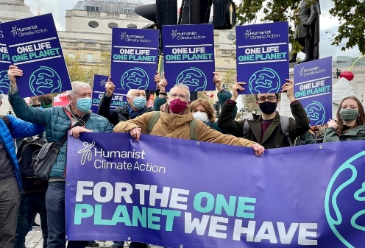
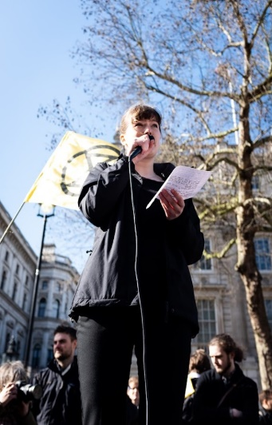
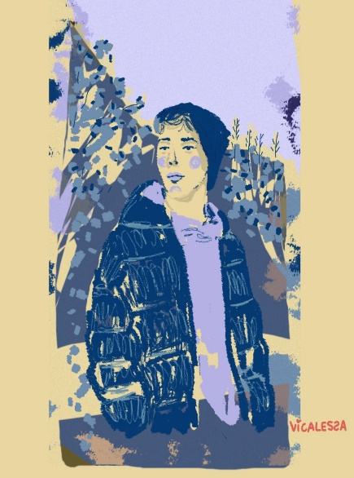
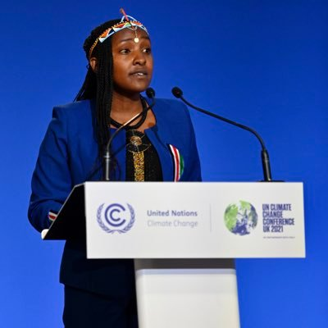
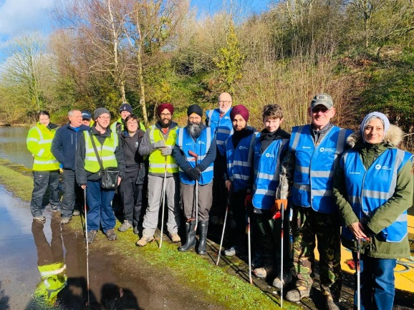
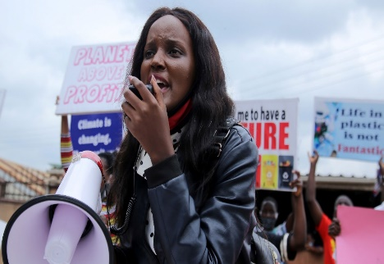
Read through your stories:
What do you think inspired each person to take action?
Are there similarities / differences between them?
Why do you find them inspiring?

Slide 11

Pick one of the people you have read about:
On the other side of your leaf:
- How do they inspire you?
On one side of your leaf:
- What inspires them to work for climate justice?

Slide 12
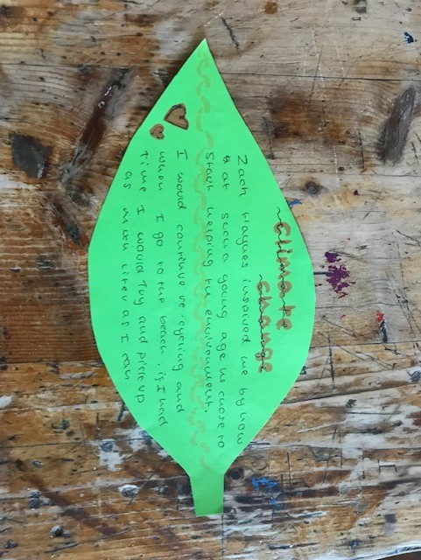
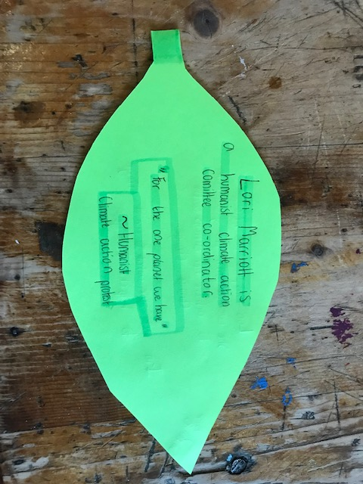
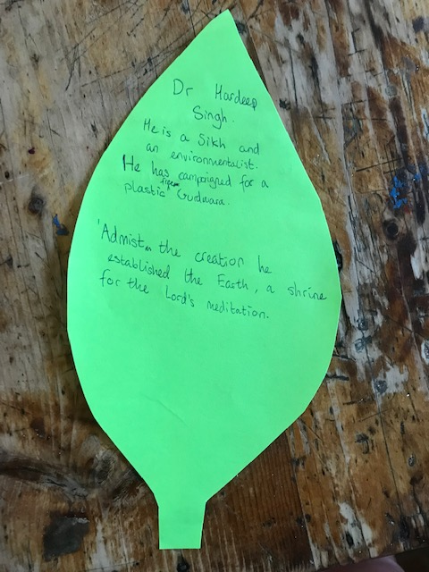
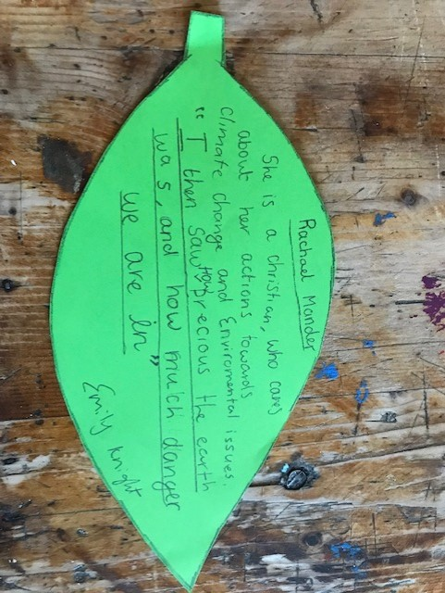
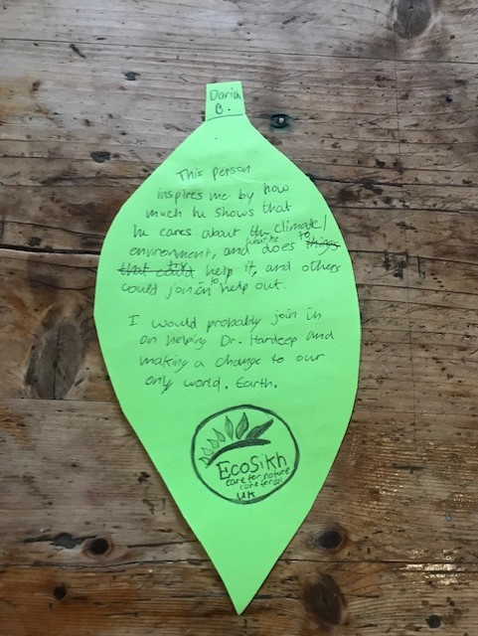
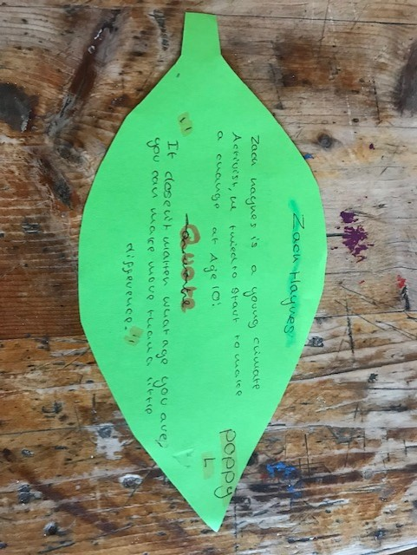

Slide 13
My Climate Story
Quick response starter questions
What is their ‘own climate story’?
Creative Response - Triarama
- Art
Poetry
Prose

Slide 14
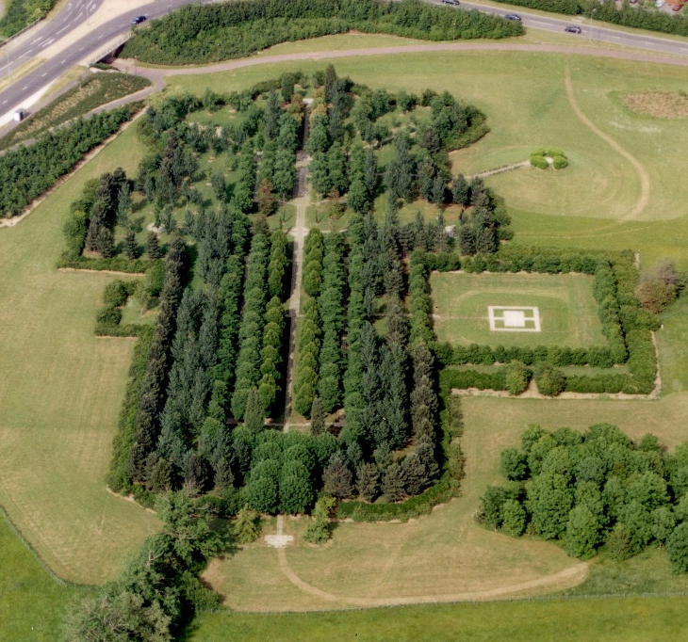
Going forward
Roll out to the whole year group in 2022/23
Depth, rather than breadth?
Longer scheme of work?
Learning outside the classroom?
Application in the school / community?

